Slide 1
Comprehensive SEO Audit & Optimization for Organic Traffic Growth
Bharani Kadamban S (MBT8)

Slide 2

Chosen Company Website
Adobe - https://www.adobe.com/in/

Slide 3
Adobe
Adobe Inc., founded in December 1982 by John Warnock and Charles Geschke
Renowned for its innovation, Adobe's flagship products, such as Photoshop, Illustrator, and Acrobat, have revolutionized creative industries.
Adobe Creative Cloud offers a comprehensive suite of tools for design, video editing, web development, and photography. Adobe Experience Cloud empowers businesses with advanced analytics, marketing automation, and e-commerce solutions.
Committed to sustainability and diversity, Adobe fosters a culture of creativity and inclusivity, continually shaping the future of digital experiences across industries worldwide.

Slide 4
Services provided:
Adobe Creative Cloud: An all-encompassing suite featuring industry-leading tools like Photoshop, Illustrator, Premiere Pro, and After Effects, facilitating top-tier design, video production, web development, and photography.
Adobe Document Cloud: Transforming document workflows with Adobe Acrobat and Adobe Sign, enabling seamless PDF creation, editing, signing, and sharing.
Adobe Experience Cloud: A robust platform for data-driven marketing, advertising, analytics, and commerce, delivering personalized and impactful customer experiences.
Adobe Stock: Providing a vast collection of premium images, graphics, videos, and templates to elevate creative projects.
Adobe Sensei: Leveraging AI and machine learning to automate tasks, enhance workflows, and provide intelligent insights.
Adobe Fonts: Offering an extensive library of high-quality fonts to enrich design projects with professional typography

Slide 5
Task 1 – Initial Audit
The Overall site score is 60/100 and it is good score.
Page title and meta descriptions are good and set to be in correct length and catchy words
Clean and descriptive URLs, enhancing readability and SEO
STRENGTH
Page has correct number of internal and external links.
User-friendly navigation with clear menus and logical flow and visually appealing and professional design, reflecting Adobe's brand identity.
The Page responsive time is 0.2 seconds, it is excellent one.
WEAKNESS
Some images on the page have no alt attribute.
Both the page title and meta description are missing keywords.

Slide 6
Task 2 – Keyword Research
Keyword research is the process of identifying and analyzing the search terms that people enter into search engines.
This helps us to understand what our target audience is looking for and allows us to optimize the content to rank higher in search results.
Targeted Keywords:
Photoshop tutorials, buy Photoshop, Photoshop subscription, Adobe reader
Adobe Acrobat Pro, PDF editor, best PDF software, Adobe podcast
Adobe Experience Cloud
Keyword | Search Volume (K) | Keyword Difficulty | Competition Level
Marketing automation tools | 15,000 | Medium | Low
Digital marketing platforms | 20,000 | High | Medium
Adobe Experience Cloud | 5,000 | Low | Low

Slide 7
Task 2 – Keyword Research Adobe Creative Cloud & Adobe Acrobat
Keyword | Search Volume (K) | Keyword Difficulty | Competition Level
Photoshop tutorials | 50,000 | Medium | Low
Buy Photoshop | 20,000 | Medium | Low
Premiere Pro tutorials | 30,000 | Medium | Low
Illustrator vs CorelDraw | 10,000 | High | Medium
Keyword | Search Volume (K) | Keyword Difficulty | Competition Level
Adobe Acrobat Pro | 40,000 | Medium | Low
PDF editor | 35,000 | High | Medium
Best PDF software | 25,000 | Low | Low

Slide 8
Task 2 – Keyword Research
Competitor Keywords and Strategies
Competitor: Corel (CorelDRAW)
Top Keywords: CorelDRAW tutorials, CorelDRAW vs Illustrator, Buy CorelDRAW, CorelDRAW features
Content Strategy:
Corel focuses heavily on creating detailed tutorials and how-to guides for their products.
They produce comparison content (e.g., CorelDRAW vs Adobe Illustrator) to attract users who are deciding between products
Competitor: Affinity (Serif)
Top Keywords: Affinity Photo vs Photoshop ,Affinity Designer tutorials, Buy Affinity Photo, Affinity Publisher features
Content Strategy:
Emphasize the cost-effectiveness of their products compared to Adobe.
Detailed breakdowns of specific features that set them apart.
Strong community presence with forums and user-generated content.

Slide 9
Task 3 – On-Page SEO Optimization Audit
Page 1 : https://www.adobe.com/in/acrobat/business.html
The Overall score for the page is 78/100
STRENGTH
Title Tags, HTML tags are good but need to optimize the meta description up to 160 words only
Page has a correct number of internal and external links. (Internal -16 , External - 2)
Well optimized in canonical tag, Performance, UX, Page size
Site has a robots.txt file which includes one or more Disallow: directives.
WEAKNESS
The title of page has 76 characters. Most search engines will truncate meta titles to 75 characters.
Some images on the page have no alt attribute
The primary keywords could be better integrated into the content for improved optimization.
Sometimes the page is slow due to high-resolution images and embedded videos

Slide 10
Task 3 – On-Page SEO Optimization Audit
Page 2 : https://www.adobe.com/in/acrobat/personal-document-management.html
The Overall score for the page is 74/100
STRENGTH
Good usage of Title Tags, HTML tags, meta description
Well optimized in canonical tag, Performance, Page size
Clear and structured use of H1, H2, and H3 tags helps in easy navigation and content organization.
WEAKNESS
Need to optimize the internal and external link. (Internal -9 , External - 6)
Some images on the page have no alt attribute
The integration of primary keywords is not optimal throughout the content.

Slide 11
Task 3 – On-Page SEO Optimization Audit
Page 3 : https://www.adobe.com/in/products/illustrator/features.html
The Overall score for the page is 81/100
STRENGTH
Good Enhanced Title Tags, HTML tags meta description .
Page has a correct number of internal and external links. (Internal -14 , External - 1)
Page response time is under 0.2 seconds which is great.
The page design is clean, modern, and user-friendly, offering an intuitive navigation experience.
WEAKNESS
Some images on the page have no alt attribute
No Schema.org data found on your homepage
While the page is generally responsive, but certain elements could be better optimized for mobile devices

Slide 12
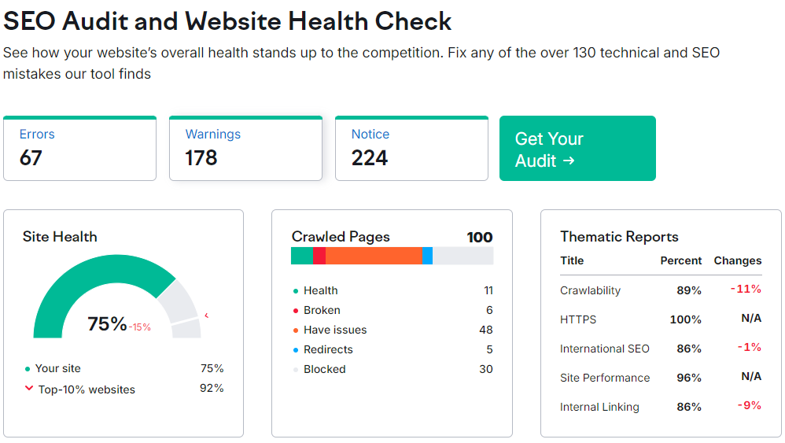
Task 4 – Technical SEO Audit
Home Page:
https://www.adobe.com/in/
Technical SEO Issues
Some images on the page have no alt attribute
No H1and H2 tag were found
Robots.txt file is missing or unavailable
Best Practices:
Optimize Load Time: Enhance speed by compressing images, leveraging browser caching, and optimizing code.
Mobile Responsiveness: Ensure the site adapts seamlessly to different screen sizes and devices.
Navigation: Simplify the menu structure and ensure consistent labelling for easy user navigation.
Accessibility Compliance: Implement features that adhere to accessibility standards for better usability.
SEO Enhancements: Improve meta tags, alt texts, and structured data for better search engine visibility.
Technical SEO Audit Report

Slide 13
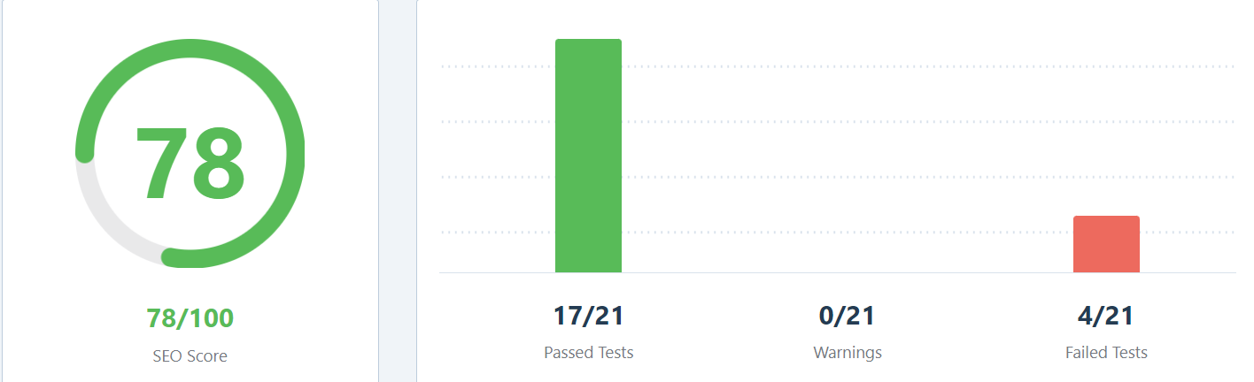
Task 4 – Technical SEO Audit
www.adobe.com/in/acrobat/business.html
Technical SEO Issues
Some images on the page have no alt attribute
Keywords could be better integrated into the content for improved optimization
Best Practices:
Enhance User Experience: Simplify the interface and navigation to make it more intuitive for users to find information quickly.
Boost SEO: Update meta tags, alt texts, and use structured data to improve search engine visibility.
Mobile Optimization: Ensure the page is fully responsive and performs well on all mobile devices.
Technical SEO Audit Report

Slide 14
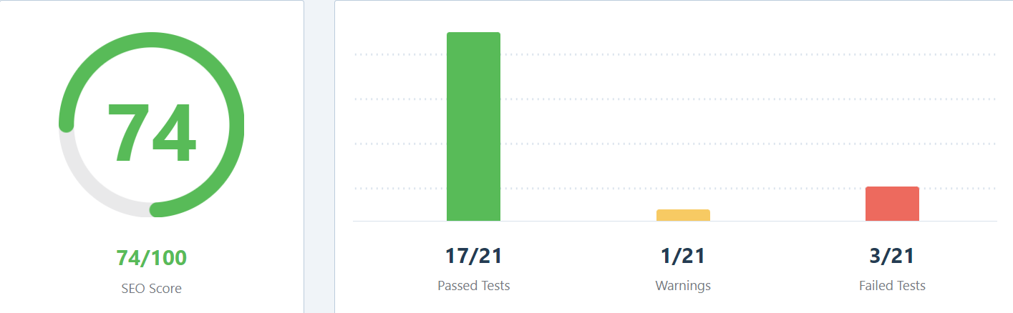
Task 4 – Technical SEO Audit
https://www.adobe.com/in/acrobat/personal-document-management.html
Technical SEO Issues
Some images on the page have no alt attribute
Too few internal links (9).
No Schema.org data found on your homepage.
Best Practices:
Page Load Optimization: Minimize load times by optimizing images and scripts.
Responsive Design: Ensure seamless performance across all devices, particularly mobile.
User-Centric Navigation: Simplify navigation and enhance user flow for easier access to information.
Technical SEO Audit Report

Slide 15
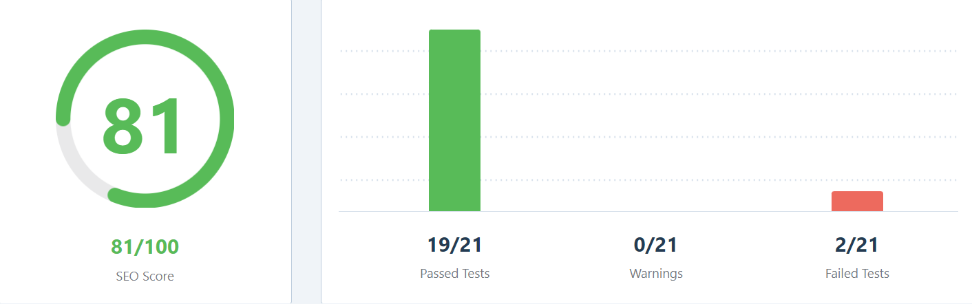
Task 4 – Technical SEO Audit
https://www.adobe.com/in/products/illustrator/features.html
Technical SEO Issues
Some images on the page have no alt attribute
No Schema.org data found on your homepage.
Best Practices:
Mobile Responsiveness: Ensure the page adapts smoothly across different devices.
Clear Visual Hierarchy: Use consistent headings and visual cues to guide users through the content.
Content Optimization: Improve SEO by refining meta tags, using structured data, and enhancing keyword usage.
Technical SEO Audit Report

Slide 16
Task 5 – Content Strategy
1.Keyword Research
Primary Keywords: Adobe Creative Suite, PDF Editor, Digital Marketing Software
Secondary Keywords: Graphic Design Tools, Document Management Software, E-signature Solutions
Long-tail Keywords: Best software for creative professionals, How to edit PDFs online, Digital marketing automation tools
2.Audience Analysis
Target Audience: Creative professionals, businesses, digital marketers, educators.
Main Points: Need for efficient design tools, document management, and digital marketing solutions.
3.Content Types
Blog Posts:
Topics: “How to Leverage Adobe Tools for Remote Work”
Focus: SEO-optimized, educational content targeting specific user needs.

Slide 17
Task 5 – Content Strategy
3.Content Types
Videos
Topics: “Step-by-Step Guide to Using Adobe Photoshop”
Focus: Engaging, tutorial-style content with SEO-optimized titles and descriptions.
Case Studies
Topics: “Enterprise Success Stories with Adobe Creative Cloud”
Focus: Detailed, result-driven content showcasing real-world applications.
Educational Posts
Topics: “Best Practices for Using Adobe Creative Cloud in Design Projects”
Focus: Informative, SEO-driven content that educates and inspires.

Slide 18
Task 5 – Content Strategy
4. Distribution Channels
SEO Optimization: Ensure all content is optimized for search engines.
Social Media: Use platforms like LinkedIn, Instagram, and YouTube to distribute content and engage with the community.
Email Marketing: Create newsletters to keep users informed about new content, product updates, and offers.
5. Performance Tracking
Metrics: Monitor website traffic, user engagement, conversion rates, and content shares.
Tools: Use Google Analytics, Adobe Analytics, and social media insights to measure success and refine strategies.

Slide 19
Task 6 – Off Page SEO
1. Link Building Strategy
High-Quality Backlinks: Focus on acquiring backlinks from authoritative websites in relevant industries, such as technology, design, software
Guest Posting: Collaborate with authorized blogs and websites to publish guest posts that include backlinks to Adobe’s website.
2. Content Marketing
Infographics: Create and distribute visually appealing infographics on topics like digital marketing trends, software tips, and creative design, which can be widely shared and linked to.
Whitepapers and E-books: Offer comprehensive whitepapers and e-books that other websites can reference, generating backlinks.
Case Studies: Publish detailed case studies on successful Adobe product implementations, which can be referenced by industry publications.

Slide 20
Task 6 – Off Page SEO
3. Social Media Engagement
Active Social Media Presence: Regularly share valuable content, updates, and resources on Adobe’s social media platforms, encouraging shares and interactions that increase visibility.
Influencer Marketing: Collaborate with influencers in the design, photography, and creative fields to promote Adobe’s products and services.
Community Building: Engage with online communities, such as Reddit and design forums, to share insights and encourage discussions around Adobe products.
4. Brand Mentions & Online Reputation Management
Brand Monitoring: Use tools to monitor online mentions of Adobe, ensuring that any unlinked mentions are converted into backlinks.
Positive Reviews: Encourage satisfied customers to leave positive reviews on third-party review sites, which can enhance trust and credibility.
Press Releases: Distribute press releases for major product launches or company news to increase brand mentions on authoritative news websites.

Slide 21
THANK YOU

